Slide 1
ONLINE FOOD ORDERING SYSTEM
– SQL CASE STUDY
A Complete Database & Business Analytics Project
By
Shubham Singh

Slide 2
INTRODUCTION
This case study focuses on building and analyzing an Online Food Ordering System using SQL.
The system enables:
Customers to browse menus, place orders, and leave reviews
Restaurants to manage menu items, track orders & performance
The business to analyze sales, customer behavior, cuisine trends, and satisfaction

Slide 3
OBJECTIVES OF THE CASE STUDY
The case study aims to:
Understand customer ordering patterns
Identify top-performing restaurants
Analyze menu popularity
Measure customer satisfaction
Evaluate revenue trends
Detect operational inefficiencies
Support predictions with data insights

Slide 4
SYSTEM OVERVIEW
The Online Food Ordering System consists of:
Customers – user personal data
Restaurants – restaurant profiles
MenuItems – list of foods offered
Orders – order transactions
OrderDetails – item-wise breakdown
Reviews – customer feedback
These tables create a complete operational and analytical system.

Slide 5
DATABASE SCHEMA OVERVIEW
A relational schema connecting six core tables:
Customers
Restaurants
MenuItems
Orders
OrderDetails
Reviews
Includes PK–FK relationships for integrity.

Slide 6
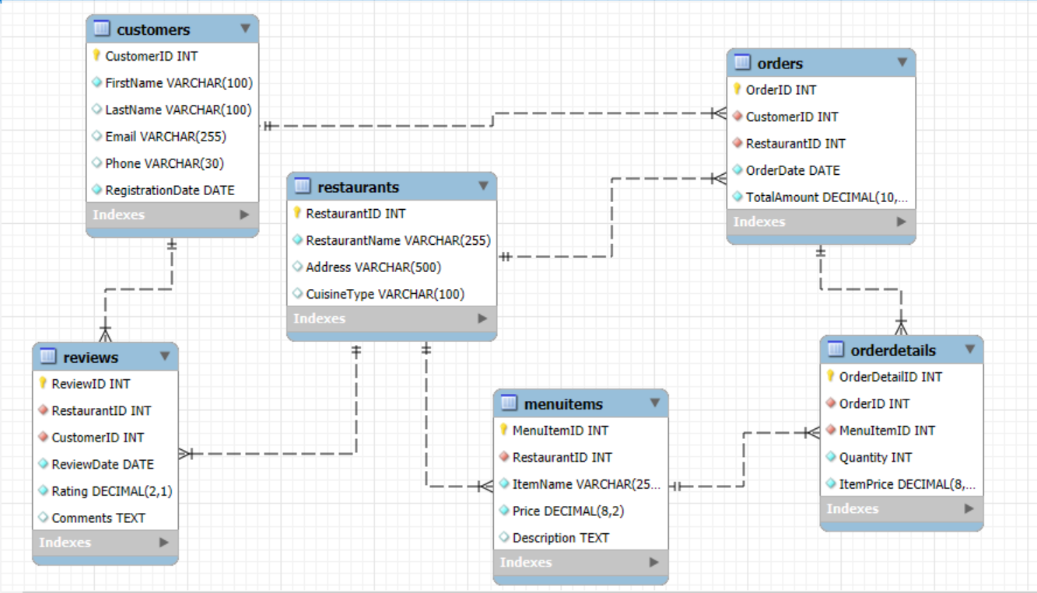
ER DIAGRAM

Slide 7
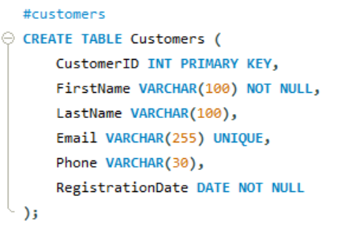
CUSTOMERS TABLE
Purpose: Stores customer identity and contact details.

Slide 8
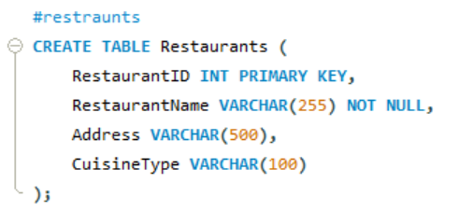
RESTAURANTS TABLE
Purpose: Represents restaurants on the platform.

Slide 9
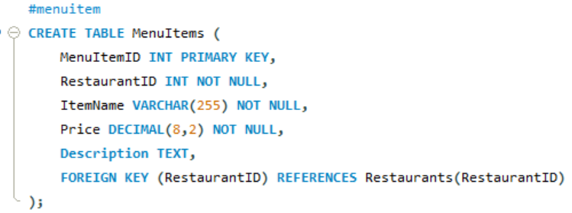
MENUITEMS TABLE
Purpose: StoresMenu items offered by each restaurant.

Slide 10
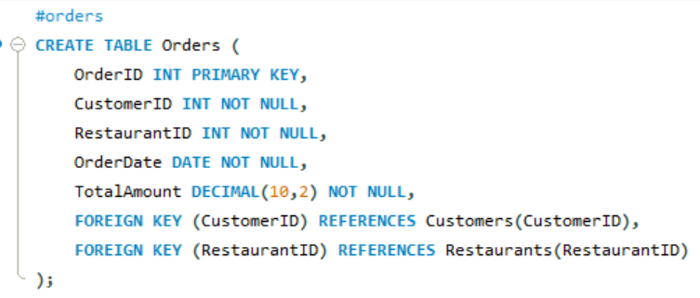
ORDERS TABLE
Purpose: Tracks orders placed by customers.

Slide 11
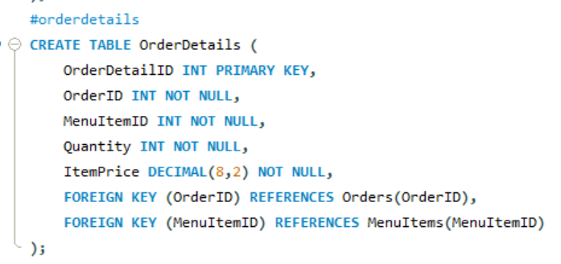
ORDERDETAILS TABLE
Purpose:Stores item-wise order data.

Slide 12
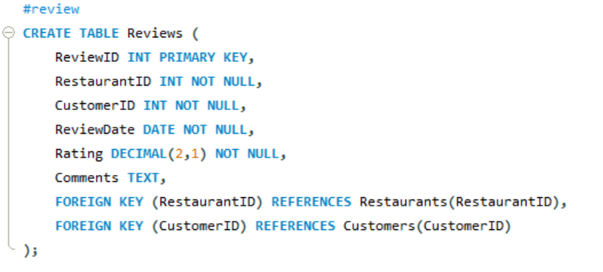
REVIEWS TABLE
Purpose: Captures customer ratings & comments.

Slide 13
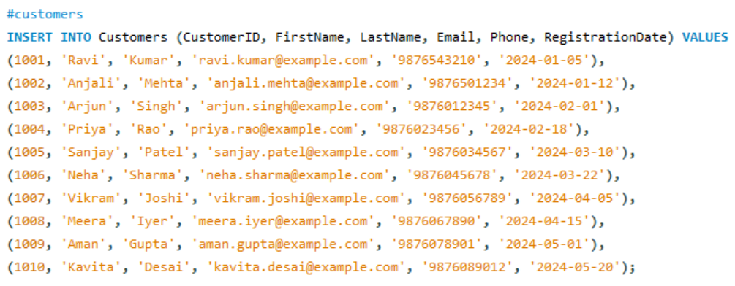
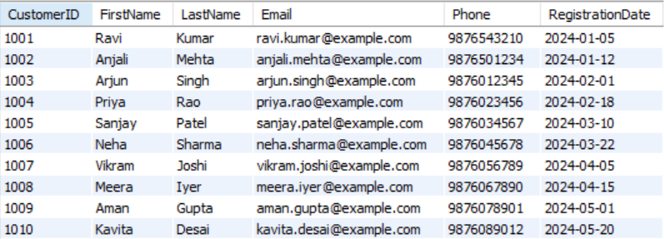
INSERTING DATA- CUSTOMERS TABLE
QUERY
TABLE

Slide 14
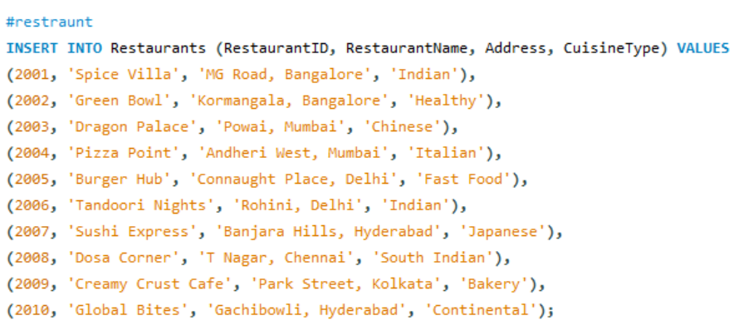
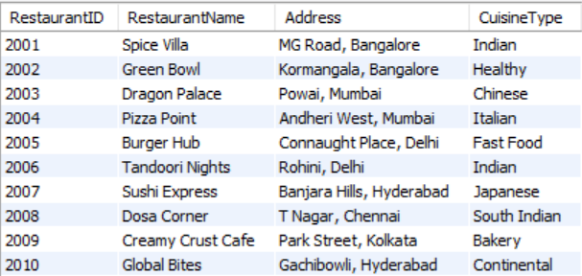
INSERTING DATA- RESTAURANTS TABLE
QUERY
TABLE

Slide 15
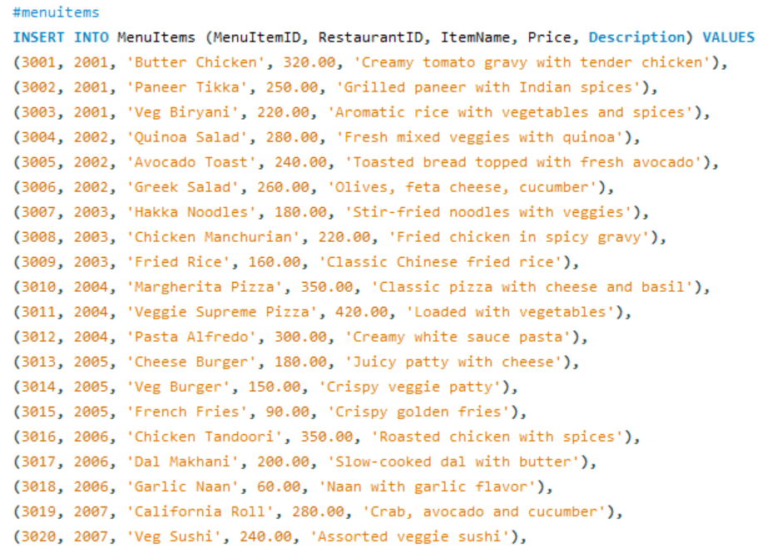
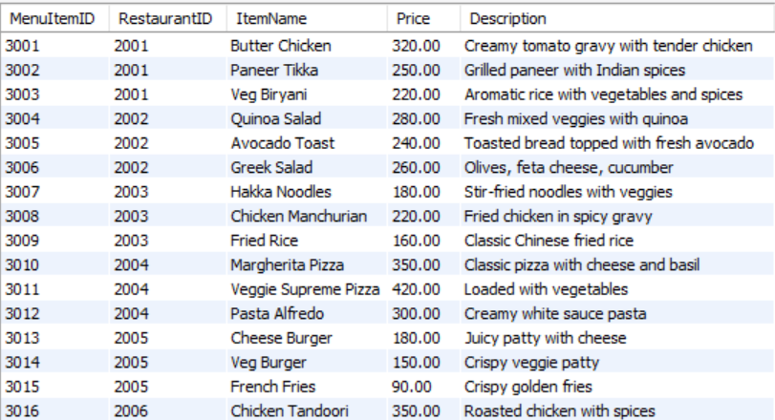
INSERTING DATA- MENUITEMS TABLE
QUERY
TABLE

Slide 16
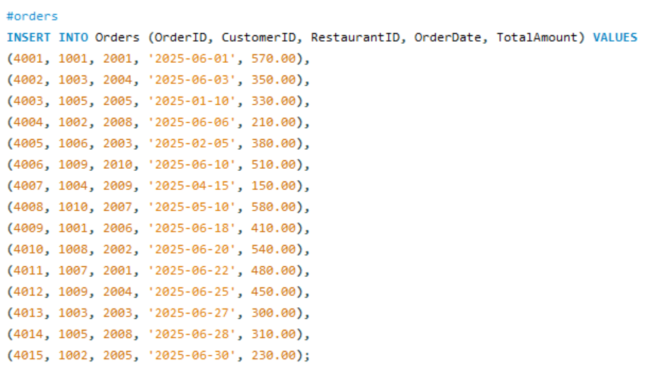
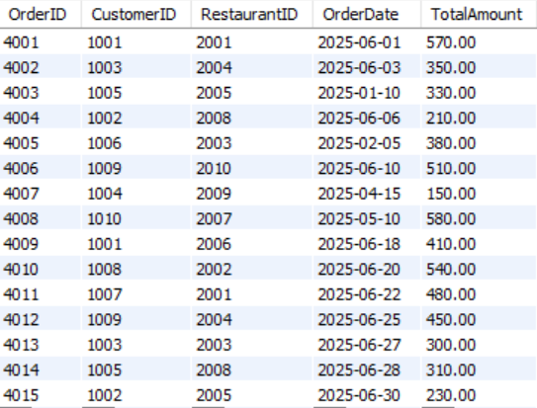
INSERTING DATA- ORDERS TABLE
QUERY
TABLE

Slide 17
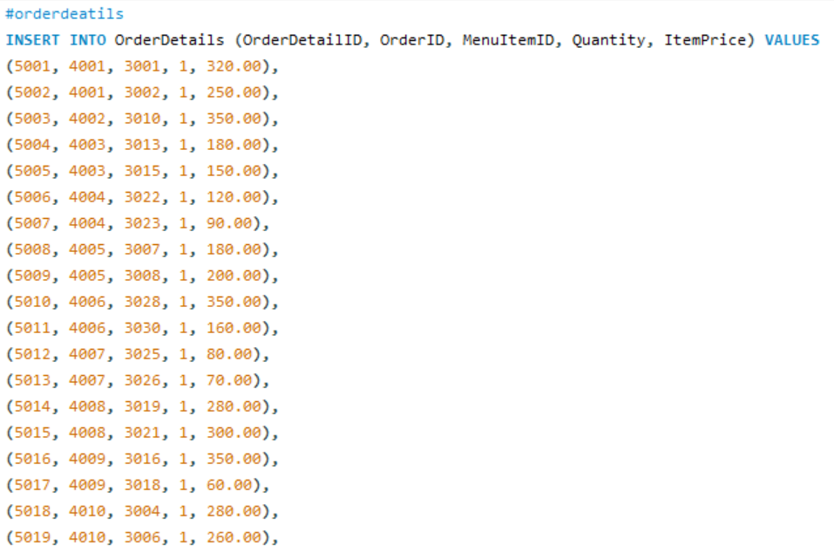
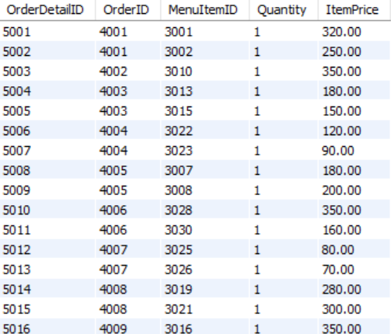
INSERTING DATA- ORDERDETAILS TABLE
QUERY
TABLE

Slide 18
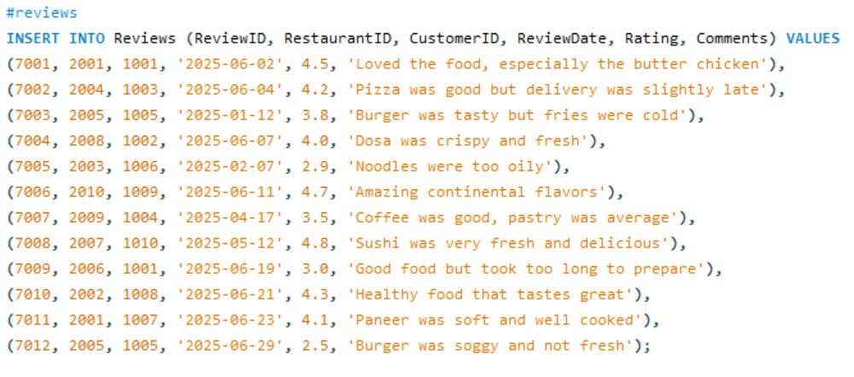
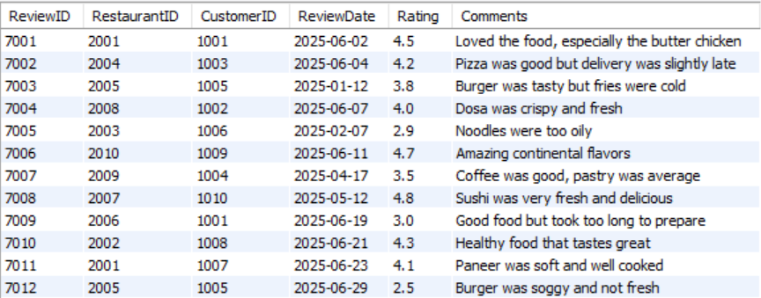
INSERTING DATA- REVIEWS TABLE
QUERY
TABLE

Slide 19
KEY ANALYSIS

Slide 20
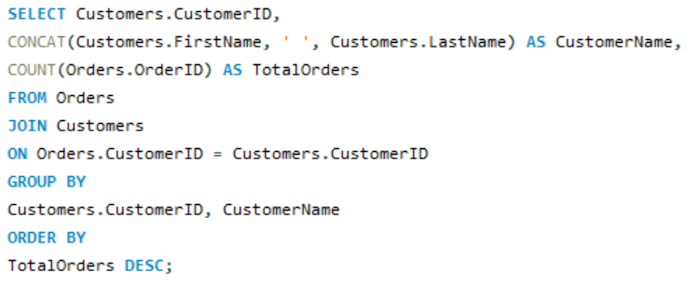
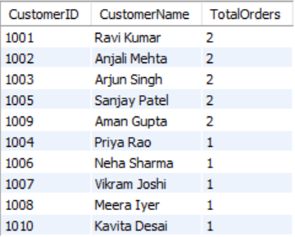
Q1.Identify customers who have placed the highest number of orders. What does this indicate about their loyalty or engagement?
QUERY
TABLE
Analysis / Answer:
The customer with the highest number of orders is the platform’s most loyal and engaged user.
They are ideal for premium offers, loyalty rewards, referral incentives.

Slide 21
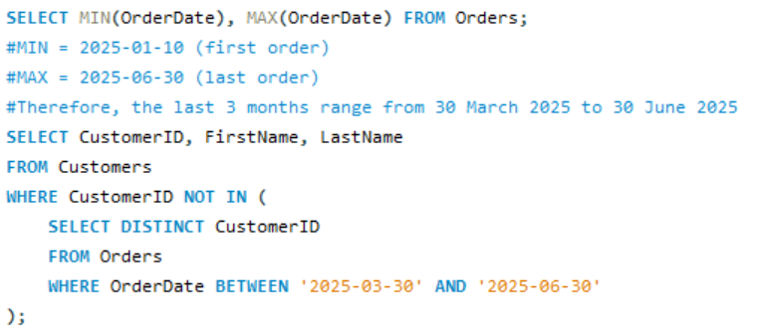

Q2.Find customers who haven’t placed any orders in the last 3 months. How can the platform re-engage them?
QUERY
TABLE
Analysis:
These customers may be lost due to:
Poor experience
High delivery charges
Competition
Re-engagement: notifications, discounts, personalized offers.

Slide 22
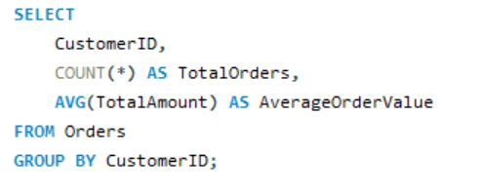
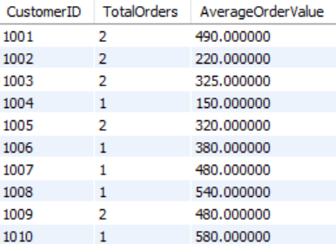
Q3.Determine the average order value per customer. What does this reveal about spending habits?
QUERY
TABLE
Analysis:
High AOV customers are premium segment
Low AOV customers may respond well to bundle deals

Slide 23
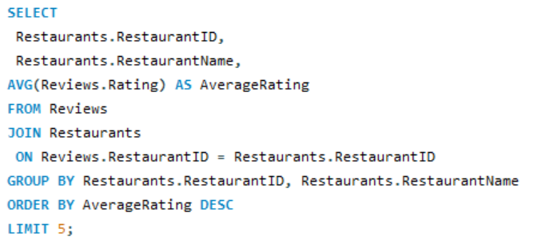
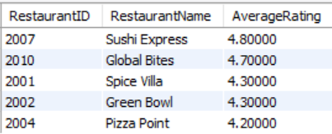
Q4.Identify the top 5 restaurants with the highest average ratings. What factors might contribute to their success?
QUERY
TABLE
Analysis:
Factors: good food quality, timely delivery, popular cuisine.

Slide 24
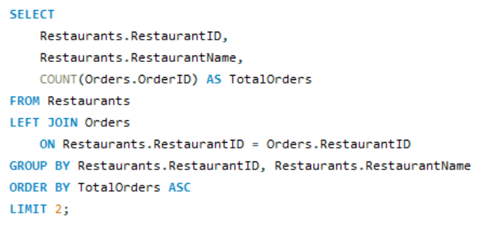

Q5.Find restaurants with the lowest number of orders despite being active. What could be causing low performance?
QUERY
TABLE
Analysis:
Reasons may include:
Wrong cuisine for locality
Poor visibility
High prices
Negative reviews

Slide 25
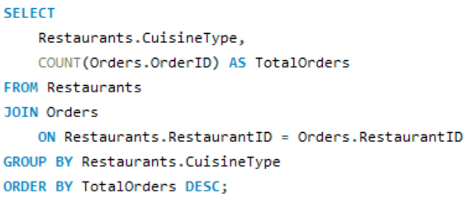
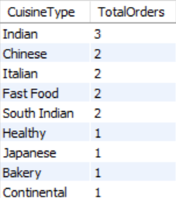
Q6.Determine which cuisine types receive the most and least orders. How can marketing focus be adjusted accordingly?
QUERY
TABLE
Analysis:
Cuisine preferences help in marketing:
Most ordered → promote via combos
Least ordered → require offers or menu redesign

Slide 26
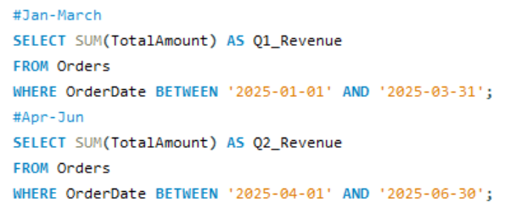


Q7.Calculate the total revenue generated in the last quarter. How does it compare to the previous one?
QUERY
TABLE
Analysis:
Shows business growth.
Q2 > Q1 → indicates expansion

Slide 27
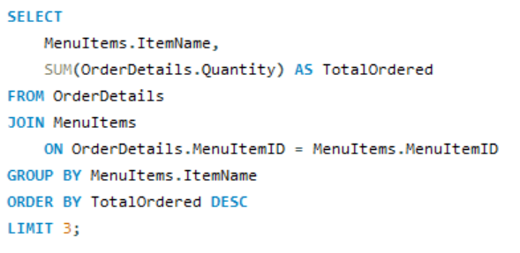
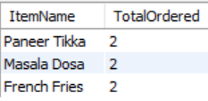
Q8.Identify the top 3 most ordered menu items across all restaurants. Should these items be promoted further?
QUERY
TABLE
Analysis:
These should be marketed more → combo deals, highlight as “Most Popular”.

Slide 28
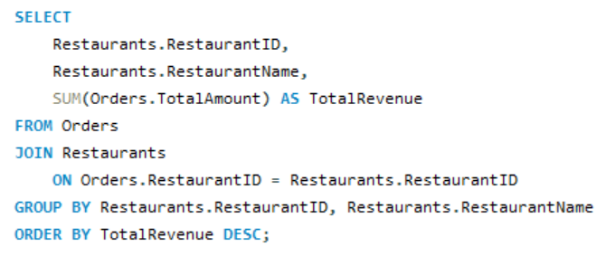
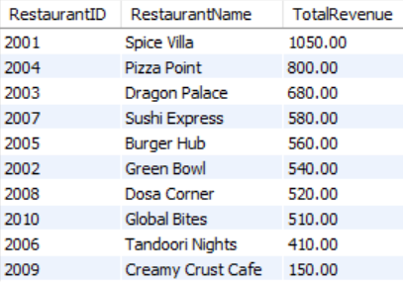
Q9.Analyze the revenue contribution of each restaurant. Which ones are the most profitable?
QUERY
TABLE
Analysis:
Identifies top revenue drivers.
Low revenue restaurants may need visibility improvement.

Slide 29
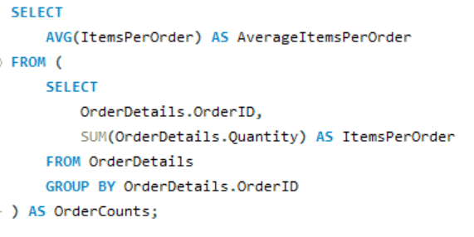

Q10.Determine the average number of items per order. How can order processing be optimized?
QUERY
TABLE
Analysis:
Higher items/order = more complex operations
Helps optimize packaging and staffing

Slide 30
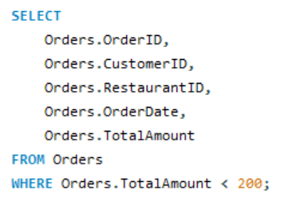

Q11.Identify orders where the total amount was less than a certain threshold (e.g., ₹200). Should minimum order charges be introduced?
QUERY
TABLE
Analysis:
Suggest adding:
Minimum order fees
Bundled pricing
Free delivery above threshold

Slide 31
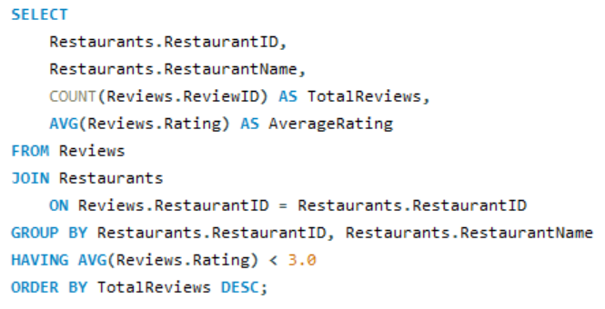

Q12.Find restaurants that receive the most reviews but have average ratings below 3.0 What corrective actions could be taken?
QUERY
TABLE
Analysis:
Indicates consistent issues → urgent action required:
Quality improvements
Staff training
Review-based compensation

Slide 32
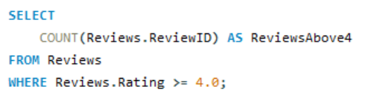

Q13.Analyze the distribution of customer ratings. How many reviews are 4 stars or above?
QUERY
TABLE
Analysis:
Shows share of positive feedback → key for NPS measurement.

Slide 33
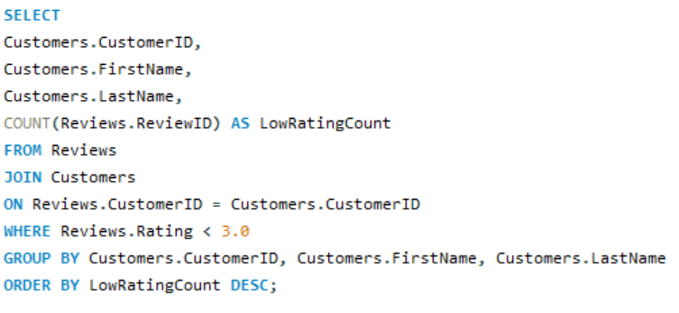

Q14.Identify customers who frequently leave low ratings. Could this indicate dissatisfaction or unrealistic expectations?
QUERY
TABLE
Analysis:
May represent dissatisfied customers
Or users with naturally high expectations
Follow-up surveys recommended.

Slide 34
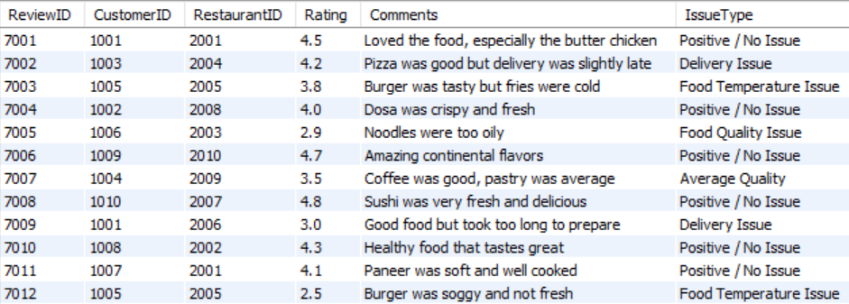
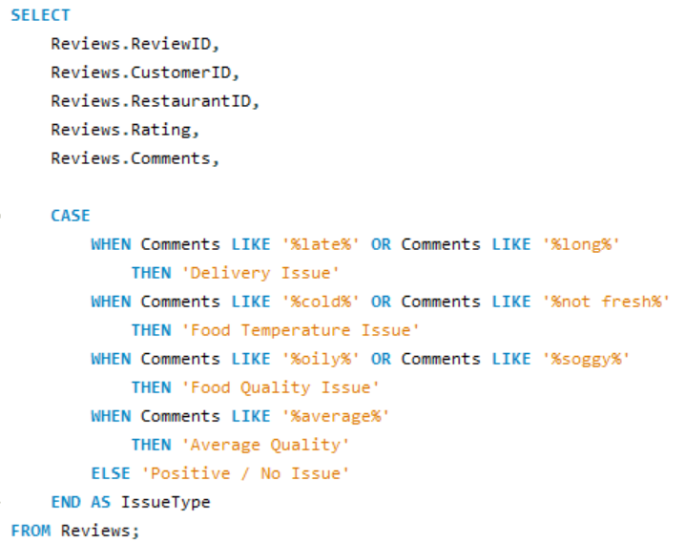
Q15.Find patterns in review comments to detect recurring issues (e.g., “cold food,” “late delivery”).
QUERY
TABLE
Analysis:
Categorizes issues:
Late delivery
Cold food
Helps prioritize operational fixes.

Slide 35
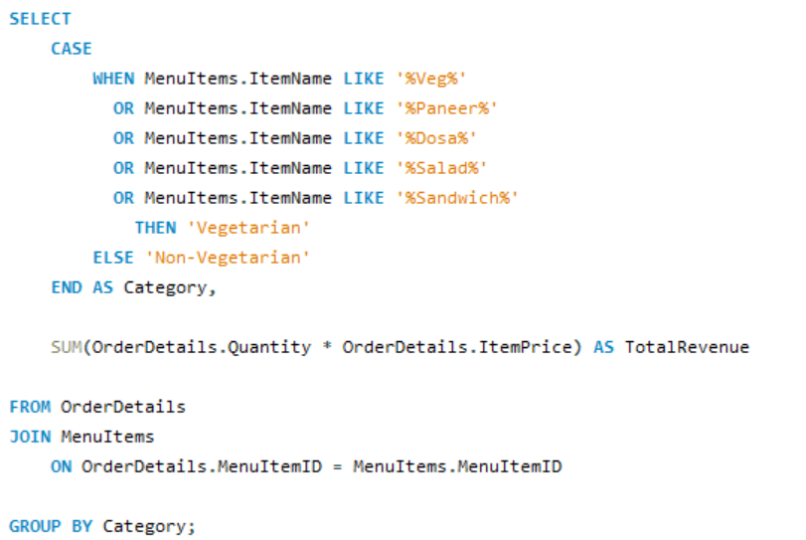

Q16.Compare total revenue from vegetarian vs non-vegetarian menu items. Should the company invest more in one category?
QUERY
TABLE
Analysis:
Shows which segment drives more revenue → helps investment strategy.

Slide 36
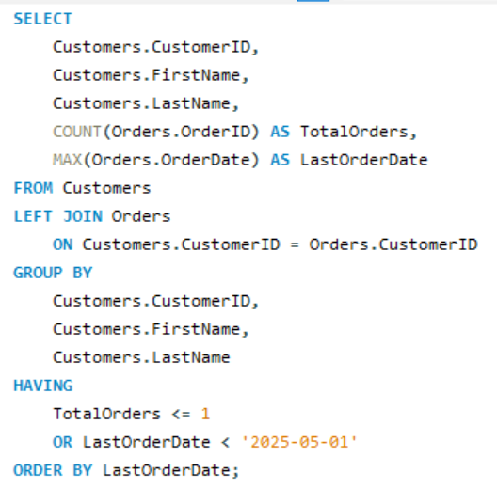
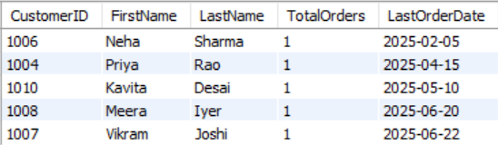
Q17.Predict which customers are likely to become inactive based on order frequency and last order date.
QUERY
TABLE
Analysis:
Based on:
Low order frequency
Old last-order date -These customers need retention campaigns.

Slide 37
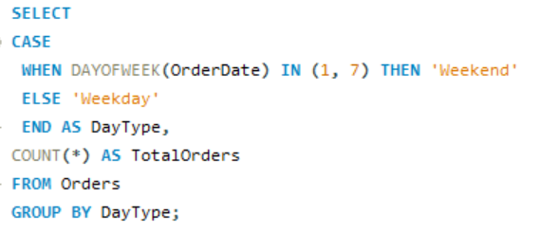

Q18) Weekend vs Weekday order trends
QUERY
TABLE
Analysis:
weekdays > weekends → weekend combos can boost sales

Slide 38
Thank you
Shubham Singh
shubhamsingh24305@gmail.com
www.shubhamsingh.space

